Slide 1
Module 5
Introduction to Transaction Processing Concepts and Theory

Slide 2
Outline
1 Introduction to Transaction Processing
2 Transaction and System Concepts
3 Desirable Properties of Transactions
4 Characterizing Schedules based on Recoverability
5 Characterizing Schedules based on Serializabilty
6 Transaction Support in SQL

Slide 3
Introduction to Transaction Processing
Transaction: An executing program (process) that includes one or more database access operations
  Read operations (database retrieval, such as SQL SELECT)
  Write operations (modify database, such as SQL INSERT, UPDATE, DELETE)
  Transaction: A logical unit of database processing
  Example: Bank balance transfer of $100 dollars from a checking account to a saving account in a BANK database
Note: Each execution of a program is a distinct transaction with different parameters
  Bank transfer program parameters:
    savings account number,
    checking account number,
    transfer amount

Slide 4
Introduction to Transaction Processing (cont.)
A transaction (set of operations) may be:
  stand-alone, specified in a high level language like SQL submitted interactively, or
  consist of database operations embedded within a program (most transactions)
Transaction boundaries: Begin and End transaction.
  Note: An application program may contain several transactions separated by Begin and End transaction boundaries

Slide 5
Introduction to Transaction Processing (cont.)
Transaction Processing Systems: Large multi-user database systems supporting thousands of concurrent transactions (user processes) per minute
Two Modes of Concurrency
  Interleaved processing: concurrent execution of processes is interleaved in a single CPU
  Parallel processing: processes are concurrently executed in multiple CPUs
  Basic transaction processing theory assumes interleaved concurrency

Slide 6
S.NO | Concurrency | Parallelism
1. | Concurrency is the task of running and managing the multiple computations at the same time. | While parallelism is the task of running multiple computations simultaneously.
2. | Concurrency is achieved through the interleaving operation of processes on the central processing unit(CPU) or in other words by the context switching. | While it is achieved by through multiple central processing units(CPUs).
3. | Concurrency can be done by using a single processing unit. | While this can’t be done by using a single processing unit. it needs multiple processing units.
4. | Concurrency increases the amount of work finished at a time. | While it improves the throughput and computational speed of the system.
5. | Concurrency deals lot of things simultaneously. | While it do lot of things simultaneously.
7. | In concurrency debugging is very hard. | While in this debugging is also hard but simple than concurrency.

Slide 7
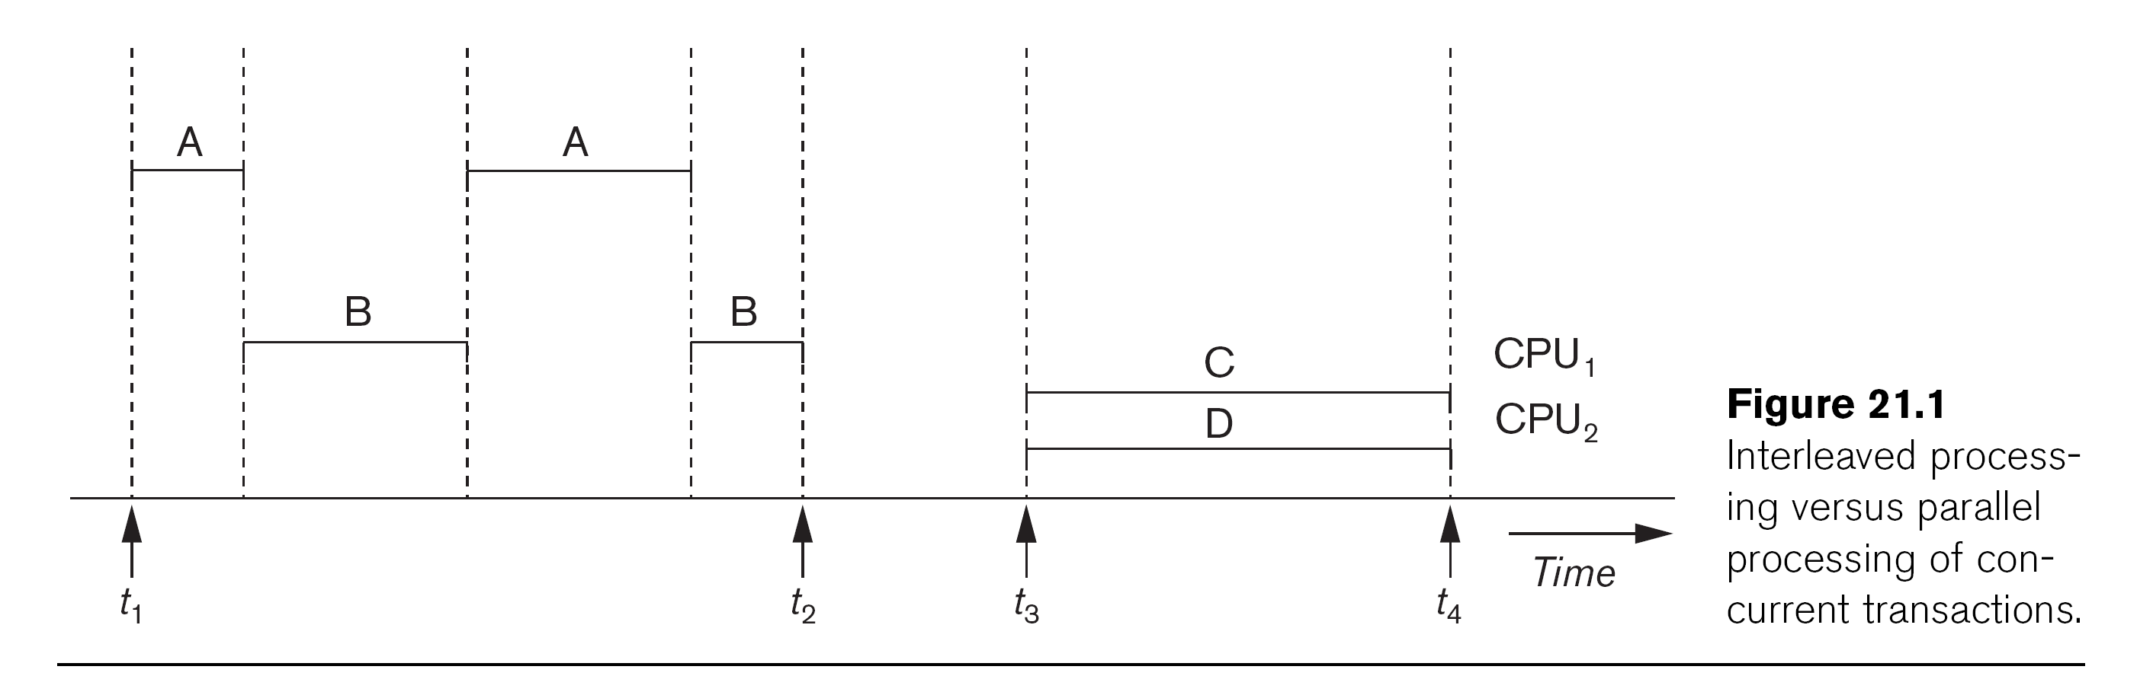
Introduction to Transaction Processing (cont.)
Source: R. Elmasri & S. B. Navathe, Fundamentals of Database Systems, Addison Wesley

Slide 8
Introduction to Transaction Processing (cont.)
For transaction processing purposes, a simple database model is used:
A database - collection of named data items
Granularity (size) of a data item - a field (data item value), a record, or a whole disk block
  TP concepts are independent of granularity
Basic operations on an item X:
  read_item(X): Reads a database item named X into a program variable. To simplify our notation, we assume that the program variable is also named X.
  write_item(X): Writes the value of program variable X into the database item named X.

Slide 9
Introduction to Transaction Processing (cont.)
READ AND WRITE OPERATIONS:
Basic unit of data transfer from the disk to the computer main memory is one disk block (or page). A data item X (what is read or written) will usually be the field of some record in the database, although it may be a larger unit such as a whole record or even a whole block.
read_item(X) command includes the following steps:
Find the address of the disk block that contains item X.
Copy that disk block into a buffer in main memory (if that disk block is not already in some main memory buffer).
Copy item X from the buffer to the program variable named X.

Slide 10
Introduction to Transaction Processing (cont.)
READ AND WRITE OPERATIONS (cont.):
write_item(X) command includes the following steps:
Find the address of the disk block that contains item X.
Copy that disk block into a buffer in main memory (if it is not already in some main memory buffer).
Copy item X from the program variable named X into its correct location in the buffer.
Store the updated block from the buffer back to disk (either immediately or at some later point in time).

Slide 11
Transaction Notation
The next slide shows two examples of transactions
Notation focuses on the read and write operations
Can also write in shorthand notation:
  T1: b1; r1(X); w1(X); r1(Y); w1(Y); e1;
  T2: b2; r2(Y); w2(Y); e2;
bi and ei specify transaction boundaries (begin and end)
i specifies a unique transaction identifier (Tid)

Slide 12

Transaction Notation
sample transactions T1 and T2

Slide 13
Why we need concurrency control
Without Concurrency Control, problems may occur with concurrent transactions:
Lost Update Problem.
Occurs when two transactions update the same data item, but both read the same original value before update.
The Temporary Update (or Dirty Read) Problem.
This occurs when one transaction T1 updates a database item X, which is accessed (read) by another transaction T2; then T1 fails for some reason; X was (read) by T2 before its value is changed back (rolled back or UNDONE) after T1 fails

Slide 14
Why we need concurrency control

Slide 15
Why we need concurrency control
The Incorrect Summary Problem .
One transaction is calculating an aggregate summary function on a number of records (for example, sum (total) of all bank account balances) while other transactions are updating some of these records (for example, transferring a large amount between two accounts, the aggregate function may read some values before they are updated and others after they are updated.

Slide 16
Why we need concurrency control

Slide 17
Why we need concurrency control
The Unrepeatable Read Problem .
A transaction T1 may read an item (say, available seats on a flight); later, T1 may read the same item again and get a different value because another transaction T2 has updated the item (reserved seats on the flight) between the two reads by T1

Slide 18
Why we need concurrency control
Causes of transaction failure:
1. A computer failure (system crash): A hardware or software error occurs during transaction execution. If the hardware crashes, the contents of the computer’s internal main memory may be lost.
2. A transaction or system error : Some operation in the transaction may cause it to fail, such as integer overflow or division by zero. Transaction failure may also occur because of erroneous parameter values or because of a logical programming error. In addition, the user may interrupt the transaction during its execution.

Slide 19
Why we need concurrency control
3. Local errors or exception conditions detected by the transaction:
- certain conditions necessitate cancellation of the transaction. For example, data for the transaction may not be found. A condition, such as insufficient account balance in a banking database, may cause a transaction, such as a fund withdrawal, to be canceled - a programmed abort causes the transaction to fail.
4. Concurrency control enforcement: The concurrency control method may decide to abort the transaction, to be restarted later, because it violates Serializabilty or because several transactions are in a state of deadlock.

Slide 20
Why we need concurrency control
Disk failure: Some disk blocks may lose their data because of a read or write malfunction or because of a disk read/write head crash. This kind of failure and item 6 are more severe than items 1 through 4.
6. Physical problems and catastrophes: This refers to an endless list of problems that includes power or air-conditioning failure, fire, theft, sabotage, overwriting disks or tapes by mistake, and mounting of a wrong tape by the operator.

Slide 21
Transaction and System Concepts
A transaction is an atomic unit of work that is either completed in its entirety or not done at all. A transaction passes through several states.
Transaction states:
Active state (executing read, write operations)
Partially committed state (ended but waiting for system checks to determine success or failure)
Committed state (transaction succeeded)
Failed state (transaction failed, must be rolled back)
Terminated State (transaction leaves system)

Slide 22
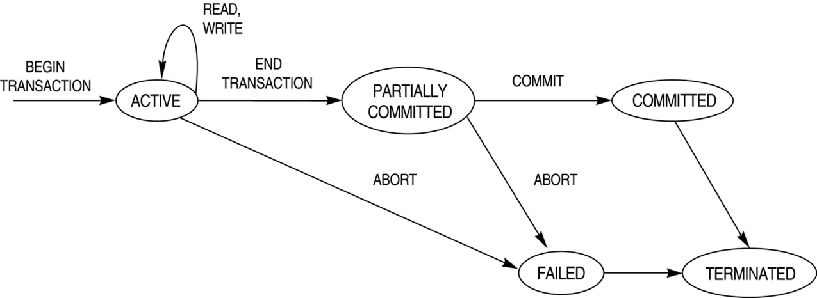
Transaction and System Concepts

Slide 23
Transaction and System Concepts
DBMS Recovery Manager needs system to keep track of the following operations (in the system log file):
begin_transaction: Start of transaction execution.
read or write: Read or write operations on the database items that are executed as part of a transaction.
end_transaction: Specifies end of read and write transaction operations have ended.
System may still have to check whether the changes (writes) introduced by transaction can be permanently applied to the database (commit transaction); or whether the transaction has to be rolled back (abort transaction) because it violates concurrency control or for some other reason.

Slide 24
Transaction and System Concepts
Recovery manager keeps track of the following operations (cont.):
commit_transaction: Signals successful end of transaction; any changes (writes) executed by transaction can be safely committed to the database and will not be undone.
abort_transaction (or rollback): Signals transaction has ended unsuccessfully; any changes or effects that the transaction may have applied to the database must be undone.

Slide 25
Transaction and System Concepts
System operations used during recovery:
undo(X): Similar to rollback except that it applies to a single write operation rather than to a whole transaction.
redo(X): This specifies that a write operation of a committed transaction must be redone to ensure that it has been applied permanently to the database on disk.

Slide 26
Transaction and System Concepts
The System Log File
Is an append-only file to keep track of all operations of all transactions in the order in which they occurred. This information is needed during recovery from failures.
Log is kept on disk-not affected except for disk or catastrophic failure
As with other disk files, a log main memory buffer is kept for holding the records being appended until the whole buffer is appended to the end of the log file on disk
Log is periodically backed up to archival storage (tape) to guard against catastrophic failures.

Slide 27
Transaction and System Concepts
Types of records (entries) in log file:
[start_transaction,T]: Records that transaction T has started execution.
[write_item,T,X,old_value,new_value]: T has changed the value of item X from old_value to new_value.
[read_item,T,X]: T has read the value of item X (not needed in many cases).
[end_transaction,T]: T has ended execution
[commit,T]: T has completed successfully, and committed.
[abort,T]: T has been aborted.

Slide 28
Transaction and System Concepts
The System Log (cont.):
protocols for recovery that avoid cascading rollbacks do not require that read operations be written to the system log; most recovery protocols fall in this category
strict protocols require simpler write entries that do not include new_value

Slide 29
Transaction and System Concepts
Commit Point of a Transaction:
Definition: A transaction T reaches its commit point when all its operations that access the database have been executed successfully and the effect of all the transaction operations on the database has been recorded in the log file (on disk). The transaction is then said to be committed.

Slide 30
Transaction and System Concepts
Commit Point of a Transaction (cont.):
Log file buffers: Like database files on disk, whole disk blocks must be read or written to main memory buffers.
For log file, the last disk block (or blocks) of the file will be in main memory buffers to easily append log entries at end of file.
Force writing the log buffer: before a transaction reaches its commit point, any main memory buffers of the log that have not been written to disk yet must be copied to disk.
Called force-writing the log buffers before committing a transaction.
Needed to ensure that any write operations by the transaction are recorded in the log file on disk before the transaction commits

Slide 31
Desirable Properties of Transactions
ACID properties:
Atomicity, Consistency, Isolation, Durability
Atomicity: A transaction is an atomic unit of processing; it is either performed in its entirety or not performed at all. This is known as “ all-or-nothing” property
Execution of a transaction is interrupted by any sort of failure then
The transaction is terminated by undoing all the action that have already executed (or)
The transaction is terminated by completing the remaining actions
Notes:
Consistency - it is completely executed from beginning to end without interference from other transactions

Slide 32
There are two types of failures
  Transaction itself may fail due to input errors, deadlock or other factors ( transaction failure)
  Second type is caused by system crash ( media failure, processor failure, communication link failure) [ crash recovery ]. Information storage may be lost or inaccessible

Slide 33
Let us consider the relational database
FLIGHT( FNO,DATE, SRC, DEST, STSSOLD,CAP)
CUST(CNAME, ADDR, BAL)
FC(FNO, DATE, CNAME, SPECIAL)
Assume the above relational database is used in reservation application.
A customer wants to book a flight. Prepare a set of transactions that are to be executed to book a flight ticket with booking agent.
Illustrate the role of ATOMICITY in this transaction.

Slide 34
ACID Properties (cont…)
Consistency preservation: A correct execution of the transaction must take the database from one consistent state to another.
Simply ‘Correctness’ . That is, a transaction is a correct program that maps one consistent database state to another.
Dirty data refers to data values that have been updated by a transaction prior to its commitment
The following are the possibilities to ensure Consistency :
T does not overwrite dirty data of other transaction
T does not commit any writes until it completes all its writes [EOT]
T does not read dirty data from other transactions
Other transactions do not dirty any data read by T before T completes

Slide 35
ACID Properties (cont…)
Isolation: Even though transactions are executing concurrently, they should appear to be executed in isolation – that is, their final effect should be as if each transaction was executed in isolation from start to finish.
Isolation property of a transaction which requires each transaction to see a consistent database at all times
In other words, an executing transaction cannot reveal its results to other concurrent transaction before its commitment.
Cause of Dirty Read, Fuzzy Read, Phantom condition may occur if data was not isolated.

Slide 36
ACID Properties (cont…)
Durability or permanency: Once a transaction is committed, its changes (writes) applied to the database must never be lost because of subsequent failure.
This property ensures that once a transaction commits, its results are permanent and cannot be erased from the database.
This property brings the issue of database recovery, ie. How to recover the database to consistent state where all the committed actions are reflected.

Slide 37
Desirable Properties of Transactions (cont.)
Atomicity: Enforced by the recovery protocol.
Consistency preservation: Specifies that each transaction does a correct action on the database on its own. Application programmers and DBMS constraint enforcement are responsible for this.
Isolation: Responsibility of the concurrency control protocol.
Durability or permanency: Enforced by the recovery protocol.
Notes:
It is the responsibility of the transaction recovery subsystem of a DBMS to ensure atomicity.

